Slide 1
Card Dealing Robot
Chanuth David Marko Rohan

Slide 2
New Non-trivial Functions
Turn distance - Based on circle: adjust based on users
User input - determining number of cards per pile
Deal 1 card - Activates the extra motor for a specific period of time, which spins a wheel and dispenses a card from the deck
Deal 1 pile (linear) - Uses deal 1 card function in a for loop
Drives, deals cards, continues forward
Deal 1 pile (radial) - Drives, turns, deals cards, returns to centre
Determine maximum number of cards per player - Dependant on number of players
One line calculation
Colour selections 1-4 (4 different functions)
Executes a pre-programmed series of actions to deal cards in a specific way
6 Additional Functions

Slide 3
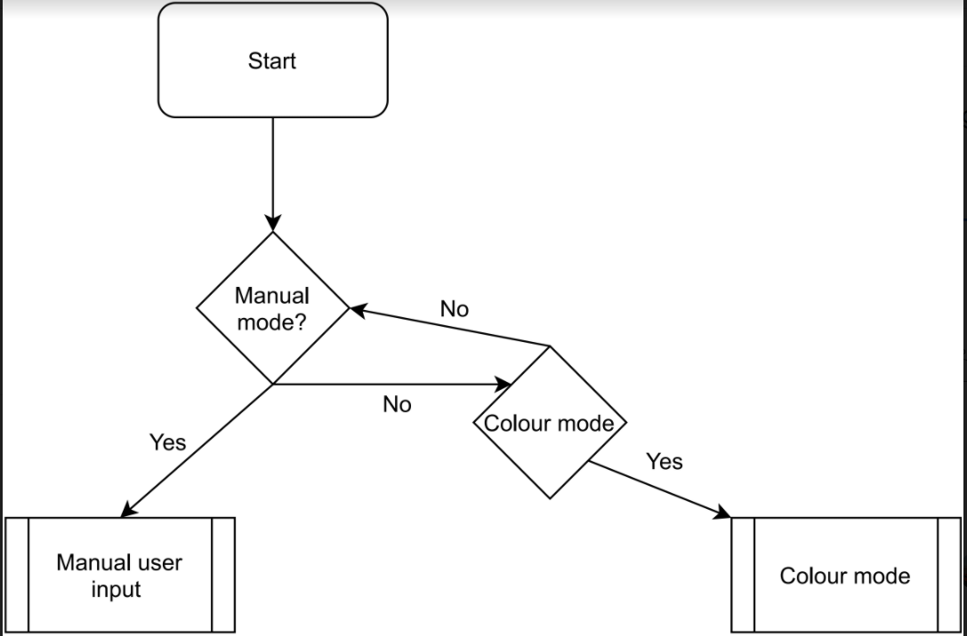
MAIN PROGRAM

Slide 4
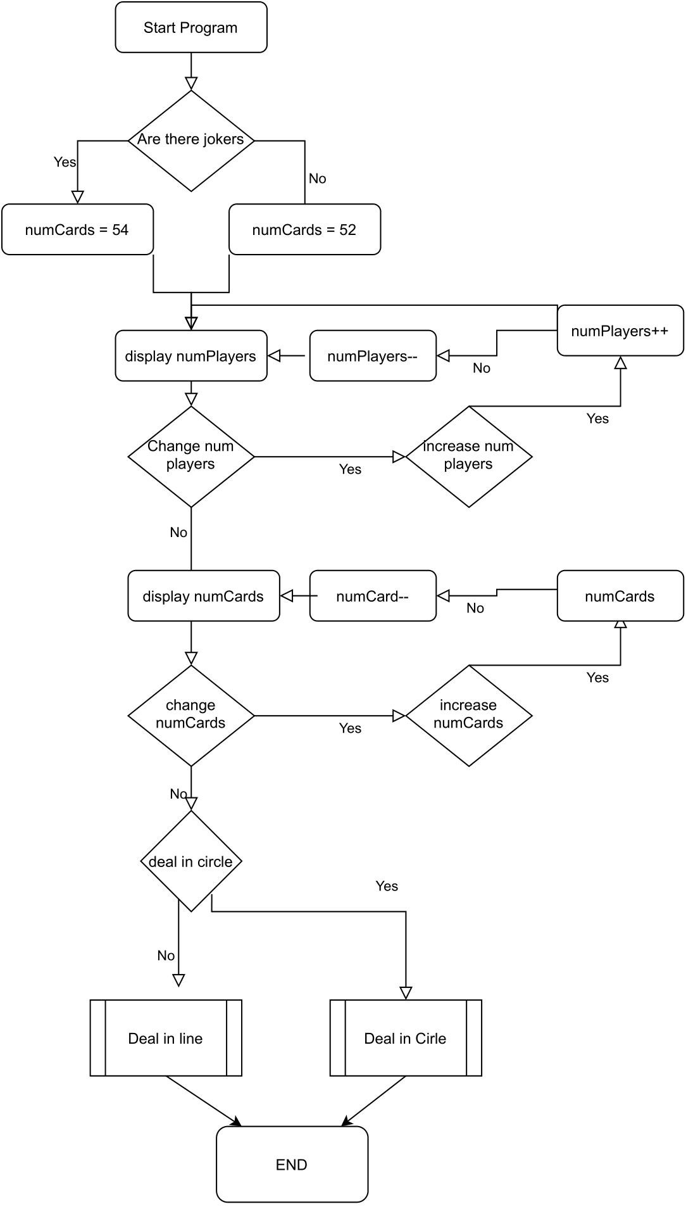
USER INPUT

Slide 5
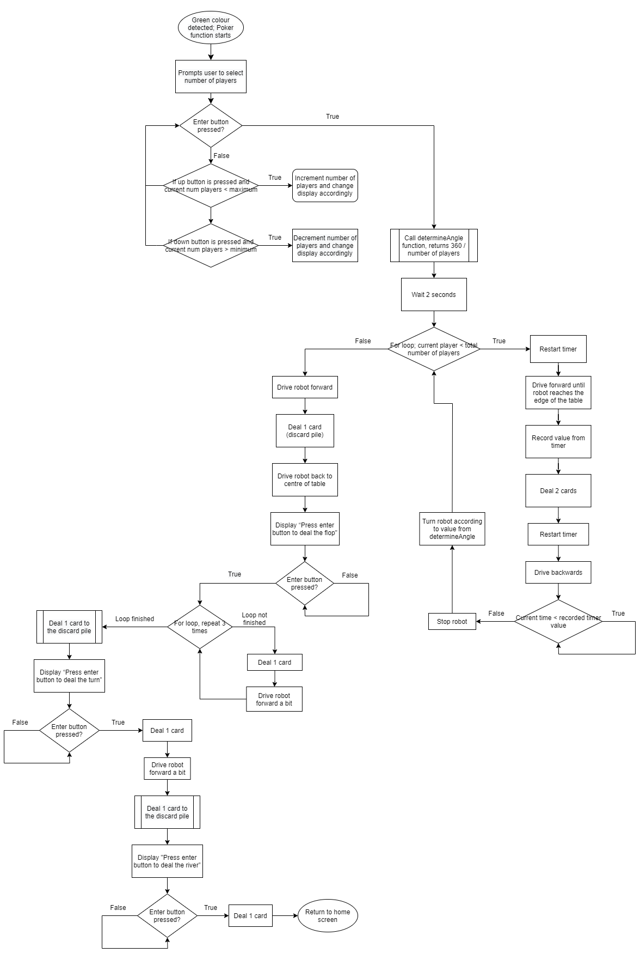
POKER

Slide 6
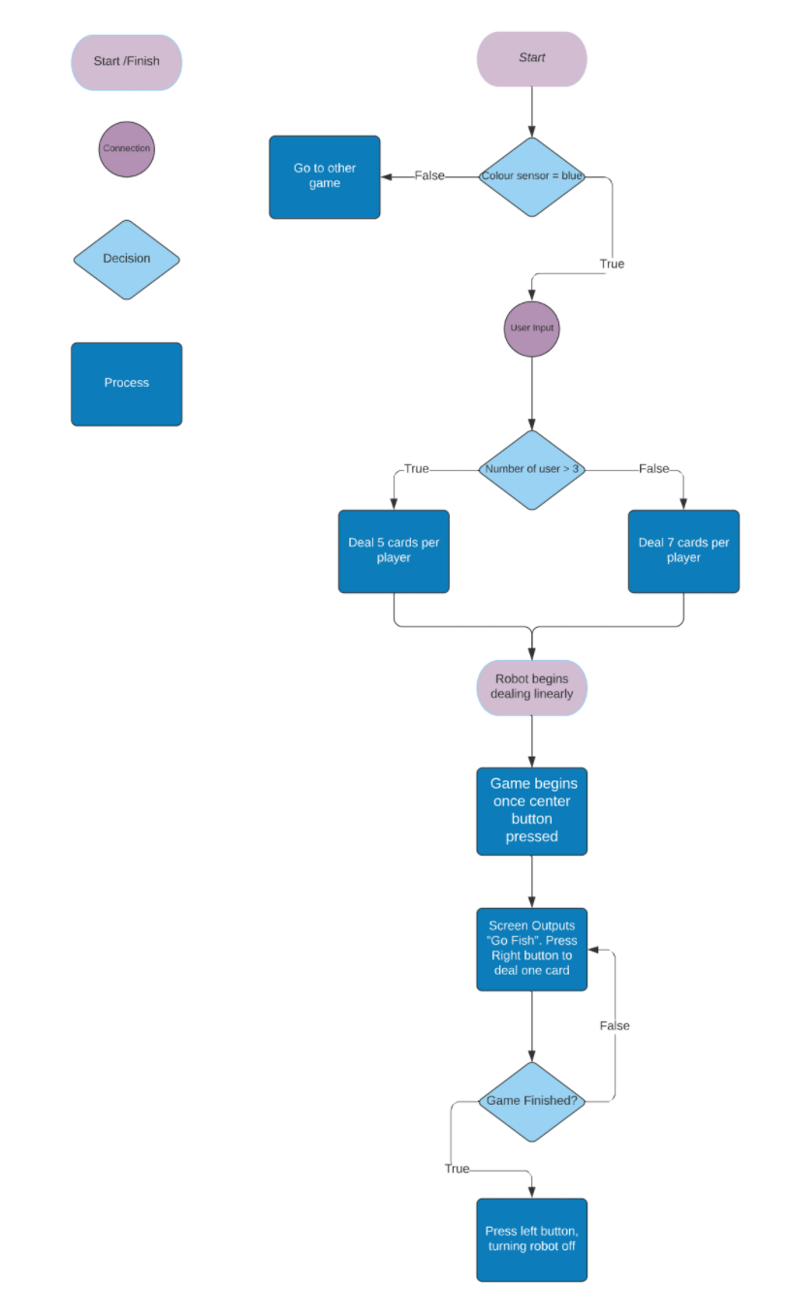
GO FISH

Slide 7
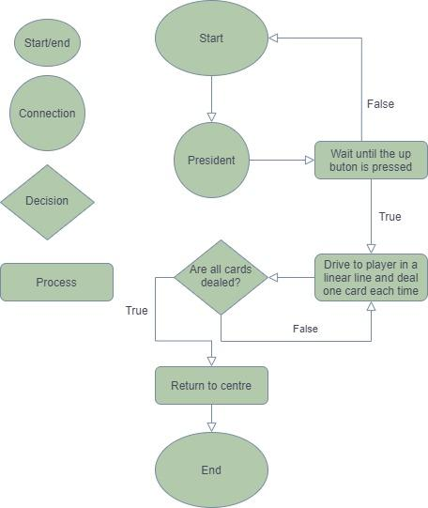
PRESIDENT

Slide 8
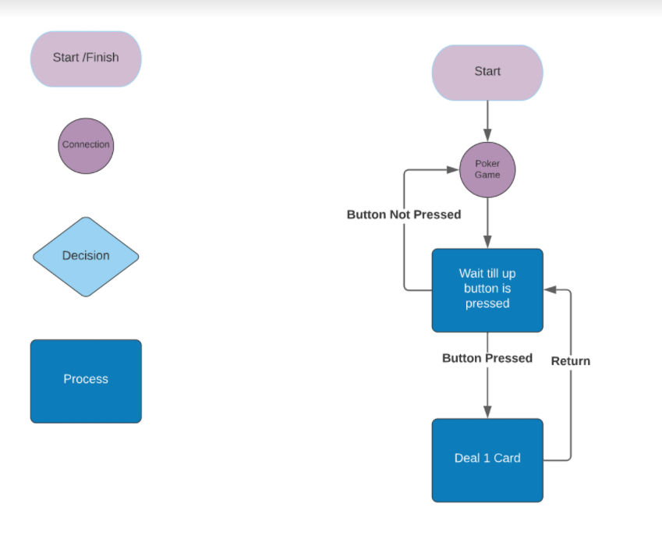
QUICK DEAL

Slide 9
SUMMARY OF DATA USED BY PROGRAM
Variables
Card counter (int)
Decrements as cards are dealt
Turn angle (float)
For radial dealing
User input
Number of players (int)
Number of cards per player (int)
Jokers included (bool)
Linear deal (bool)
Colour detected (int)

Slide 10
TASKS PER PERSON
Chanuth
President Code
Creating Deal Card Function
Creating Drive Distance Function
Rohan
Go Fish & Quick Deal Code
Creating Colour Selection Function
Creating Configure Sensors Function
David
Main & User Input Code
Creating Linear Deal Function
Creating Maximum Cards per Player Function
Marko
Poker Code
Creating Radial Deal Function
Creating Turn Distance Function

Slide 11
TESTING

